Slide 1
Recent Appellate Decisions: the good, the bad, and the ugly
Dani Cepernich & Nate Mitchell

Slide 2
Procedural Cases of Note

Slide 3
Washington Townhomes, LLC v. Washington County Water Conservancy District, 2016 UT 43

Slide 4
In re Estate of Willey, 2016 UT 53

Slide 5
Robinson v. Jones Waldo Holbrook & McDonough, PC, 2016 UT App 34

Slide 6
Stellia Ltd. v. Yknot Global Ltd., 2016 UT App 133
(don’t be fooled – it’s really the “two-dismissal rule”!)

Slide 7
Holmes v. Cannon, 2016 UT 42

Slide 8
The Good

Slide 9
Nau v. Safeco Ins. Co. of Illinois, 2017 UT App 44

Slide 10
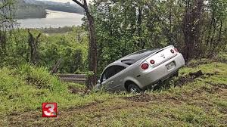
Heslop v. Bear River Mut. Ins. Co., 2017 UT 5

Slide 11
Nielsen ex rel. C.N. v. Bell ex rel. B.B., 2016 UT 14

Slide 12
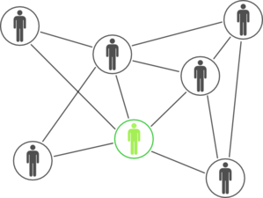
ClearOne, Inc. v. Revolabs, Inc., 2016 UT 16

Slide 13
Falkenrath v. Candela Corporation, 2016 UT App 76

Slide 14
Slip-and-Fall Update
Wood v. Salt Lake City Corp., 2016 UT App 112
MacFarlane v. Applebee’s Rest., 2016 UT App 158

Slide 15
The Bad

Slide 16
Wilson v. Educator's Mutual, 2016 UT App 38

Slide 17
M.J. v. Wisan, 2016 UT 13

Slide 18
Lancer Ins. Co. v. Lake Shore Motor Coach Lines, Inc., 2017 UT 8

Slide 19
The Ugly!

Slide 20
SIRQ, Inc. v. Layton Cos., Inc., 2016 UT 30

Slide 21
Benda v. Roman Catholic Bishop of Salt Lake City, 2016 UT 37

Slide 22
Bagley v. Bagley, 2016 UT 48

Slide 23
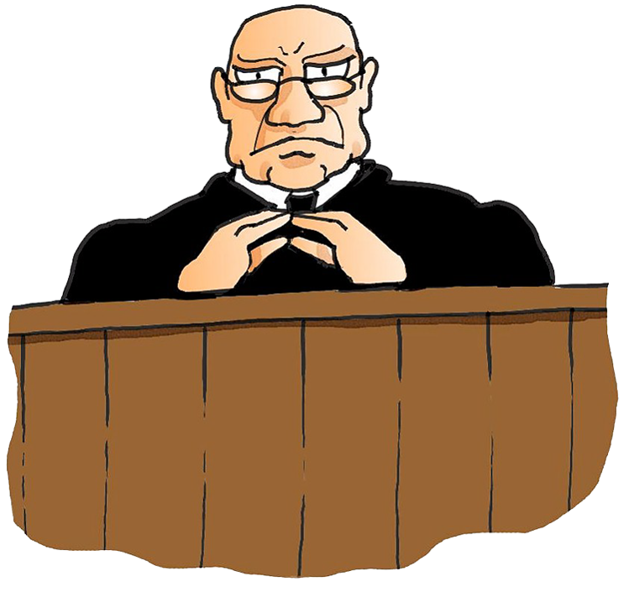
Penunuri & Siegwart v. Sundance Partners, Ltd., 2016 UT App 154

Slide 24
Discovery Traps for the Unwary
Sleepy Holdings LLC v. Mountain W. Title,
2016 UT App
Baumann v. the Kroger Co., 2016 UT App 165
RJW Media Inc. v. Heath, 2017 UT App 34
Gines v. Edwards, 2017 UT App 47

Slide 25
Thank You!
Questions?
Comments?
Requests for a copy of the summaries?
Contact:
Dani Cepernich
dnc@scmlaw.com
801-322-9264
Nate Mitchell
njm@scmlaw.com
801-322-9330

