Slide 1
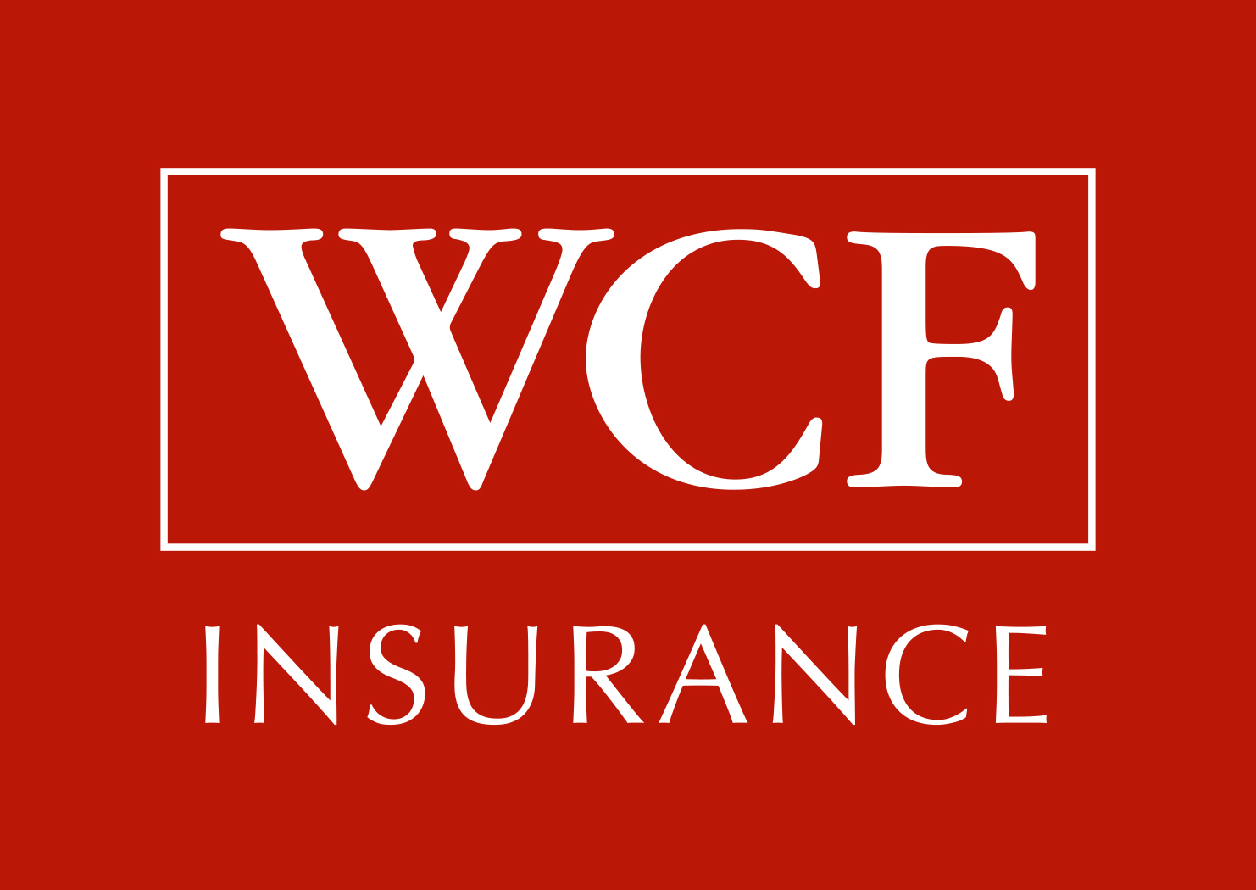
Workers Compensation and COVID-19
____
Hailey Black
Attorney
WCF Mutual Insurance Company
(385) 351-8274
hblack@wcf.com

Slide 2
Are Covid-19 claims made by injured workers compensable?
Maybe
Considerations:
The policy of insurance.
The Utah Workers Compensation Act
The Utah Occupational Disease Act

Slide 3
Part One: Workers Compensation Insurance
Part Two: Employers Liability Insurance

Slide 4
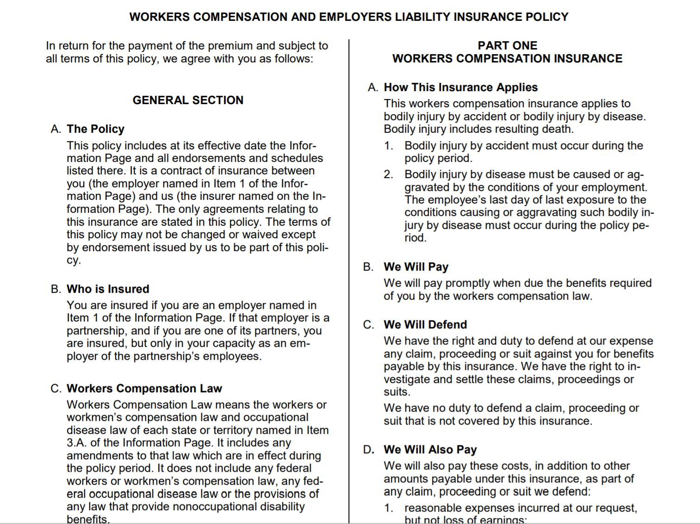

Slide 5
Conditions of Employment:
Lung cancer Asbestosis Silicosis Poisoning | Vs. | Carpal tunnel Cold virus Seasonal Flu

Slide 6
Utah Workers’ Compensation Act
Utah Code Ann. § 34A-2-1, et seq.
Utah Occupational Disease Act
Utah Code Ann. § 34A-3-1, et seq.

Slide 7
Utah Workers’ Compensation Act
Provides for payment of compensation benefits and medical expenses where an employee suffers “injury by accident arising out of and in the course of employment.”
Requires a claimant to prove there was an accident.
Requires a claimant to prove a work accident medically and legally caused injury. The standard of proof is preponderance of the evidence.
Apportionment is unavailable. § 34A-2-1, et seq

Slide 8
Utah Occupational Disease Act
Extends workers’ compensation benefits to a disease or illness that arises out of and in the course of employment and is medically caused or aggravated by that employment.
Apportionment is available:
Compensation payable by the employer is reduced and limited to the proportion the occupational exposure contributed to the condition in comparison to other causative factors. Apportionment is available where any part of a disease:
is causally related to employment with a non-Utah employer not subject to commission jurisdiction;
is of a character to which the employee may have had substantial exposure outside of employment or to which the general public is commonly exposed;
is aggravated by any other disease or infirmity not itself compensable; or
when disability or death from any other cause not itself compensable is aggravated, prolonged, accelerated, or in any way contributed to by an occupational disease.

Slide 9
Ruedas v. Utah Labor Commission, 2017 UT 58, 423 P.3d 1175
Justice Himonas: “Injury by accident” and “occupational disease” are terms of art that encompass more than their ordinary meanings. They must be interpreted consistent with legal precedent. Two factors should be considered in determining which act governs a claim: the unexpectedness of the accident and the definiteness as to the occurrence of injury. Injuries by accident and occupational diseases should be viewed as existing along a “spectrum. | Justice Durrant and Justice Durham: The terms “injury” and “disease” should be given their ordinary meanings. Adopts law from majority jurisdictions, i.e. Illinois: . . . It is quite generally recognized that an “injury is distinguished from a disease” by virtue of the fact that an injury has its origin in the specific, identifiable trauma or physical occurrence or, in the case of repetitive trauma, a series of such occurrences. A disease, on the other hand, originates from a source that is neither traumatic nor physical. . . Injury: a condition that results from physical trauma Disease: a condition that does not result from physical trauma but from other sources, such as exposure to environmental hazards (e.g., poisons, toxins or radiation), the invasion of foreign infectious agents (e.g., bacteria or viruses), or inherent biological or genetic defects.
Justice Lee “Injury by accident” and “occupational disease” are terms of art that encompass more than their ordinary meanings. They must be interpreted consistent with legal precedent. The sole fact for distinguishing between industrial accident and occupational disease claims should be unexpectedness.

Slide 10
HB 3007
Presumptions for First Responders
Codified as part 11 to the Workers’ Compensation Act
Covid-19 means the disease caused by severe acute respiratory syndrome.
A first responder who claims to have contracted COVID-19 during the performance of the his duties as a first responder, is presumed to have contracted COVID-19 by accident during the course of performing the his work duties.

Slide 11
“First responder” is defined broadly, pursuant to federal Families First Coronavirus Act, to include any person who provides transport, care, healthcare, comfort or nutrition to patients or others in response to COVID-19.
Proof of diagnosis requires both:
Laboratory testing; and
Diagnosis by a physician.
If a first responder refuses examination or testing, he is not entitled to the presumption.
If the first responder complies with examination and testing and is diagnosed with COVID-19, the presumption may be rebutted by a preponderance of the evidence.

Slide 12
Has the claimant tested positive for COVID-19? When?
Does the claimant have symptoms?
What was the time frame for the onset of symptoms?
Who has been in close contact (within 6 feet) with the claimant in the 14 days leading up to the date of first symptoms and since?
Did the claimant have direct contact with infectious secretions of a COVID-19 case (e.g., being coughed or sneezed on)?
Was the claimant notified they were potentially exposed to a person who tested positive for COVID-19? How close of contact did the claimant have with the person?
Was the claimant in the same indoor environment as a case for a prolonged period but did not meet the definition of close contact.
Was the claimant at a large gathering at the same time as a COVID-19 confirmed case?
Did the claimant or someone in close contact with the claimant travel in the past 14 days? What was the mode of travel and destination(s)?
Did a person participate in any large group gatherings (>10 people) in an area with known confirmed cases of community spread COVID-19?
What is the time frame for potential industrial exposure (dates/times if possible)?

Slide 13
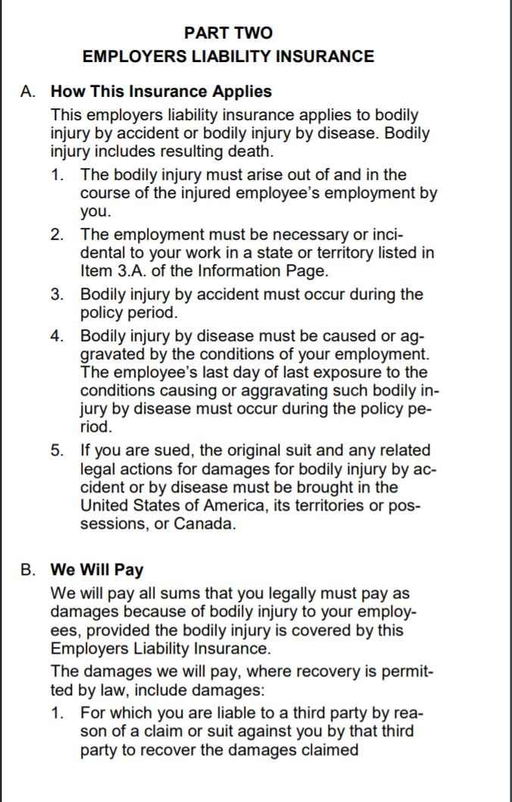
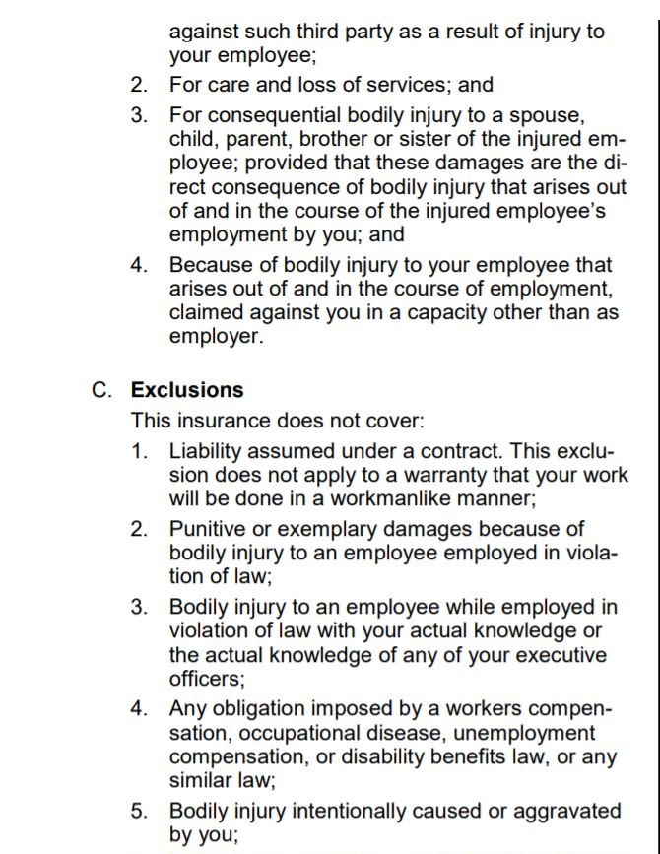

Slide 14
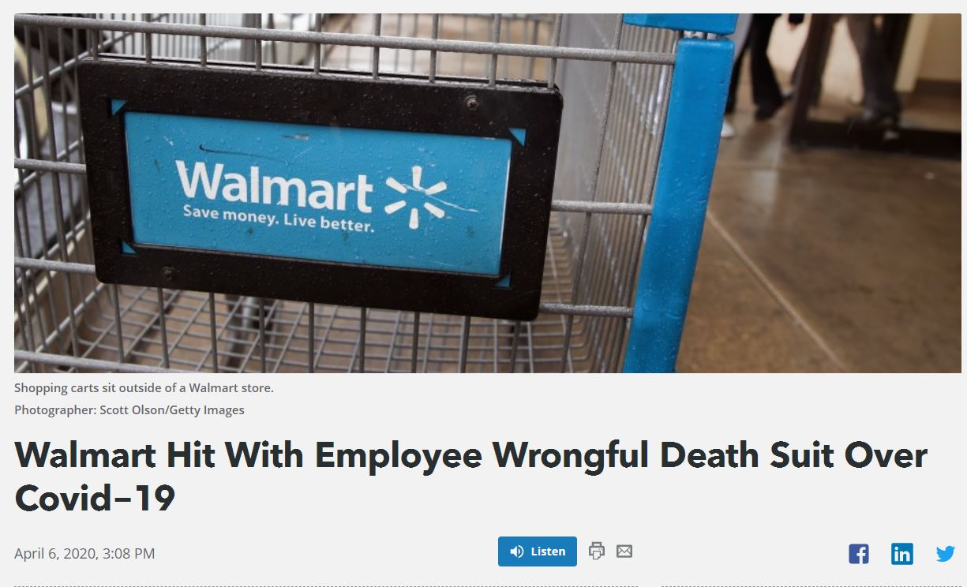
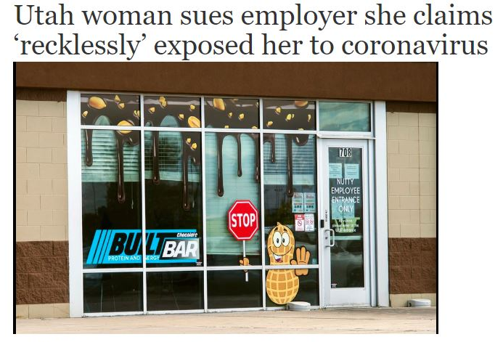
Plaintiff: family of deceased Walmart employee Walmart owed a duty “to exercise reasonable care in keeping the store a safe and healthy environment” and to protect employees when it knew of high infection risks. Causes of Action: wrongful death, negligence, willful and wanton misconduct | Plaintiffs: employee, employee’s daughter, employee’s roommate Built Bar “knowingly, intentionally and recklessly exposed its employees” to the coronavirus. Built Bar refused to provide personal protective equipment or sanitize its surfaces. Built Bar threatened to fire anyone who raised safety concerns. Causes of Action: negligence, willful misconduct, reckless infliction of harm, gross negligence

Slide 15
SB 3007/Utah Code Ann. § 78B-4-517 Immunity Related to Covid-19
. . . a person is immune from civil liability for damages or an injury resulting from exposure of an individual to COVID-19 on the premises owned or operated by the person, or during an activity managed by the person.”
Immunity does not apply to: (a) willful misconduct; (b) reckless infliction of harm; or (c) intentional infliction of harm.
Exclusive Remedy
The right to recover compensation pursuant to this chapter for injuries sustained by an employee. . . is the exclusive remedy against the employer and. . . any officer, agent, or employee of the employer and the liabilities of the employer imposed by this chapter is in place of any and all other civil liability whatsoever. . . to the employee or to the employee's spouse, widow, children, parents, dependents, next of kin, heirs, personal representatives, guardian, or any other person whomsoever, on account of any accident or injury or death, in any way contracted, sustained, aggravated, or incurred by the employee in the course of or because of or arising out of the employee's employment, and an action at law may not be maintained against an employer or against any officer, agent, or employee of the employer based upon any accident, injury, or death of an employee.

Slide 16
OTHER WORKERS’ COMPENSATION ISSUES
Temporary total disability vs. paycheck protection vs. expanded state unemployment with federal enhancement
Impact of COVID-19 shut-downs, layoffs, and furloughs on non-COVID claims
COVID-19 premium impacts
COVID-19 RESOURCES:
National Council on Compensation Insurance (NCCI), https://www.ncci.com/Articles/Pages/Insights-Coronavirus-FAQs.aspx
American Property Casualty Insurance Association (APCIA),
http://www.pciaa.net/media-center/pci-at-work/covid-19-resources
WCF Mutual Insurance Company, https://www.wcf.com/covid-19-guidance

Slide 17
Workers Compensation and COVID-19
____
Hailey Black
Attorney
WCF Mutual Insurance Company
(385) 351-8274
hblack@wcf.com

