Slide 1
2018-2019 Appellate Review: the cases that (may) affect you
Nate Mitchell & Andrew Roth

Slide 2
Tort Liability

Slide 3
Rodriguez v. Kroger, 2018 UT 25 (June 12, 2018)
Notes:
ALR:
In this appeal from a final judgment following a jury trial in a slip and fall case, the Utah Supreme Court evaluated the effect of the Liability Reform Act on liability based on a nondelegable duty. The jury had allocated 5% of fault to Smith’s, no fault to the company Smith’s contracted with to clean its floors, 75% to the individual that company contracted with to perform the cleaning, and 20% to the plaintiff. The district court refused to enter the plaintiff’s proposed judgment, which included judgment against Smith’s for 80% of the damages claim on the basis Smith’s had a nondelegable duty to keep its premises in a reasonably safe condition for business invitees, and thus should bear the independent contractor’s 75% of fault. On appeal, the supreme court reversed this ruling, holding the LRA does not preclude a judgment against one defendant that incorporates another defendant’s fault as a result of a breach of a non-delegable duty, a form of vicarious liability.

Slide 4
Colosimo v. Gateway Community Church, 2018 UT 26 (June 26, 2018)
Notes:
NJM:
In a wrongful death suit brought by the parents of a young man electrocuted while trespassing on a church’s roof due to the negligent installation of an electric sign, the supreme court clarified a distinction between a property owner’s knowledge requirement to establish a duty to trespassers versus a duty to children. While the court held that two instances over a decade of known trespass were insufficient to put the church on notice of constant or regular trespass as required by the dangerous activity doctrine, those two instances may be sufficient to show that the church had notice that children would be likely to trespass on its roof under the attractive nuisance doctrine.

Slide 5
Warrick v. Property Reserve, 2018 UT App 197 (Oct. 12, 2018)
Notes:
ALR:
In affirming the summary judgment dismissal of a slip and fall claim, the court of appeals held that constructive notice of a dangerous condition should not be imputed when conjecture and speculation are the only ways to determine the length of time the condition existed. Here, in order to demonstrate that a store owner had constructive notice of an icy sidewalk, the plaintiff had an affirmative duty to present evidence of approximately when the ice formed. Because plaintiff had presented no evidence demonstrating when the ice had formed, such as temperatures on the preceding days or nights or how long ice takes to form, summary judgment was appropriate.

Slide 6
Pinney v. Carrera, 2019 UT App 12 (Jan. 10, 2019)
Notes:
The appellant sought to overturn the jury’s award of non-economic damages to the plaintiff on the ground that she failed to show a “permanent disability or permanent impairment based upon objective findings,” as required by Utah Code § 31A-22-309(1)(a)(iii). The court interpreted this statute as requiring a plaintiff to demonstrate through evidence other than the plaintiff’s own subjective testimony that he or she has suffered either an inability to work or a loss of function that is reasonably certain to continue throughout the plaintiff’s life. Applying this definition, the court concluded that the plaintiff met the threshold requirement through testimony of her chiropractor and family members that she continued to suffer the effects of a herniated disc injury.

Slide 7
C.R. England v. Swift Transportation Company, 2019 UT 8 (Feb. 27, 2019)
Notes:
ALR:
On a certified question from the federal district court, the Utah Supreme Court declined an invitation to overturn St. Benedict’s Development Co. v. St. Benedict’s Hospital, 811 P.2d 194 (Utah 1991), which held that a plaintiff alleging intentional interference with contract must show that the defendant interfered through “improper means.” Acknowledging that St. Benedict’s had misinterpreted prior precedent, the court nonetheless concluded that the resulting “improper means” requirement was both legally sound and firmly embedded in Utah law. The court went on to clarify that “improper means” is defined in this context “as conduct contrary to law—such as violations of statutes, regulations, or recognized common-law rules—or the violation of an established standard of a trade or profession.”

Slide 8
Payan v. United Parcel Service, 905 F.3d 1162 (10th Cir. Oct. 4, 2018)
Notes:
NJM:
The plaintiff sued his former employer under Title VII and 42 U.S.C. § 1981, claiming racial discrimination and retaliation. After the plaintiff reported the discrimination to human resources, he was placed on an employee improvement plan, among other measures. On appeal from summary judgment in favor of the employer, the Tenth Circuit rejected the plaintiff’s argument that these measures constituted materially adverse employment actions under Title VII, joining the Seventh Circuit and four other circuit courts of appeal to hold instead that placement of an employee on an improvement plan alone does not constitute a materially adverse employment action.

Slide 9
Contract & Tort

Slide 10
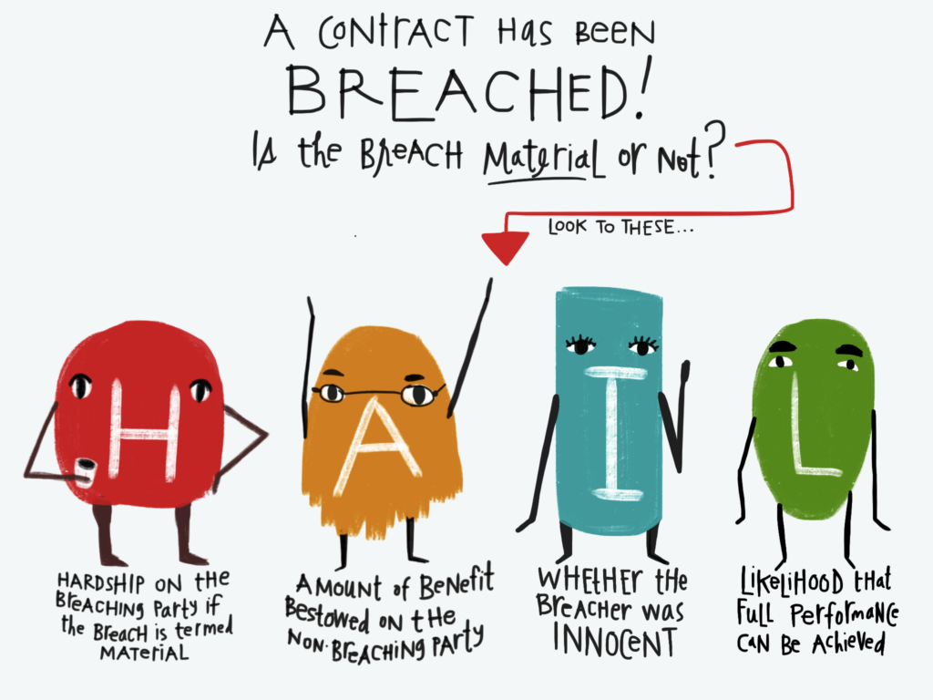
Gregory & Swapp, PLLC v. Kranendonk, 2018 UT 36 (July 26, 2018)
Notes:
NJM:
In this legal malpractice action, the jury awarded the plaintiff $2.75 million in non-economic damages arising out of emotional distress. Vacating and remanding for a new trial, the supreme court held that the trial court erred in allowing the plaintiff to recover damages for emotional distress based on a breach of contract theory, where neither the nature nor the language of the contract demonstrated that emotional distress damages were expressly contemplated by the parties.

Slide 11
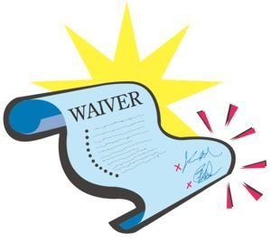
Mounteer v. HOA for the Colony, 2018 UT 23 (June 5, 2018)
Notes:
ALR:
In a dispute over a snow removal contract, Mounteer argued that the HOA had waived an insurance requirement by making payments. The HOA countered and pointed to an anti-waiver provision. At trial, the jury found the HOA had breached the contract and had implicitly waived the anti-waiver provision. In reversing the supreme court held that a party may implicitly waive an anti-waiver provision through its conduct, but there must be clear intent to waive both the underlying provision and the anti-waiver provision.

Slide 12
HealthBanc v. Synergy, 2018 UT 61 (Dec. 21, 2018)
Notes:
NJM:
This case arose from a dispute over a royalty agreement between a company that sold a health supplement and a buyer who asserted that the seller did not own the rights to the product as represented in the contract between them. On certification from the federal district court, the court held that the economic loss rule barred the plaintiff’s fraudulent inducement claims, which were duplicative of its breach of contract claim. However, the court did not resolve the broader question of whether there may ever be a fraudulent inducement claim that would not be barred by the economic loss rule.

Slide 13
Beckman v. Cybertary Franchising LLC, 2018 UT App 47 (Mar. 22, 2018)
Notes:
ALR:
This dispute centered on the termination of an employment agreement. Distinguishing a prior case in which the court had applied an objective reasonableness standard because the contract did not define “just cause,” the Court of Appeals held that where an employment agreement described specific instances that could provide a basis for early termination, the district court erred in incorporating an objective reasonableness standard in the jury instructions. The Court of Appeals also reversed the trial court’s denial of prejudgment interest and held that the unpaid wages and benefits under the employment agreement qualified for prejudgment interest because they were “ascertainable by calculation,” even though the jury awarded less than the plaintiff claimed at trial.

Slide 14
Statute of Limitations

Slide 15
Moshier v. Fisher, 2018 UT App 104 (June 7, 2018)
Notes:
ALR:
The court of appeals held that the four-year statute of limitations applied to the plaintiff’s claim for breach of contract because he had not alleged any misconduct specific to the contract and the substance of his claim was professional negligence. The court also affirmed the district court’s ruling that plaintiff did not establish circumstances warranting application of the discovery rule to delay triggering the statute of limitations.

Slide 16
Health Care Malpractice Act
Schleger v. State, 2018 UT App 84 (May 3, 2018)
Jensen v. Intermountain Healthcare, Inc., 2018 UT 27 (June 26, 2018)
Notes:
NJM:
Schleger: In this medical malpractice claim against the State, the court of appeals held that filing a pre-litigation claim, as required by the Utah Health Care Malpractice Act, prior to filing a complaint does not toll the one-year statute of limitations applicable to claims under the Governmental Immunity Act.
Jensen: In this malpractice action, the supreme court held that the four-year limitations period in the Utah Healthcare Malpractice Act operated as a statute of repose, but that a separate provision tolling the statute of limitations during the pre-litigation review process applied to the four-year statute of repose.

Slide 17
Gables v. Castlewood, 2018 UT 28 (June 29, 2018)
Notes:
ALR:
The plaintiff filed a motion for leave to amend its complaint in this construction defect case to add a new party as a defendant. By the time the plaintiff filed the complaint the 6-year statute of repose had run on the claim. Plaintiff conceded that its amended complaint did not relate back under Utah R. Civ. P. 15(c), but it argued that it was timely because the motion for leave to amend was filed within the statutory period. The district court agreed with that argument and denied the new party’s motion for summary judgment. The Utah Supreme Court reversed, holding that the claims against the new party were time-barred because an action is ”commenced” only by the actual filing of the complaint, not by filing a motion for leave to file it.

Slide 18
Expert Discovery

Slide 19
Expert Discovery & Standard of Care
Kirkham v. McConkie, 2018 UT App 100 (June 1, 2018)
Reperex, Inc. v. Coldwell Banker Commercial, 2018 UT 51 (Sep. 18, 2018)
Notes:
NJM:
Kirkham: Affirming the district court’s grant of summary judgment in favor of the defendants, the court of appeals held that expert testimony was required to prove liability on a legal malpractice claim arising out of a petition to modify child support, when the average juror would not know the standard of care expected of a family law attorney in that particular context.
Reperex: This case involved a breach of fiduciary duty claim based on a misrepresentation that the seller earned $310,000 in a single year, even though the figure was $74,000. The district court granted summary judgment based on the absence of expert testimony and the court of appeals affirmed. Reversing, the supreme court held expert testimony was not necessary, based on the particular facts of the case, where a lay person could understand the materiality of the misrepresentation without an expert’s technical input.

Slide 20
Arreguin-Leon v. Hadco Construction, 2018 UT App 225 (Dec. 13, 2018)
Notes:
ALR:
The district court allowed an expert witness to provide opinions regarding causation of an injury despite the fact that the expert had not disclosed this opinion in his deposition. The court of appeals reversed and remanded, holding that when an expert has been locked into his opinions in a deposition—by such questions as “do you have any other opinions that you expect to offer at trial”—the expert is not allowed to offer additional undisclosed opinions at trial, just as an expert who provids a report would be limited to opinions disclosed in her report.

Slide 21
California College Inc. v. UCN Inc., 2019 UT App 39 (Mar. 21, 2019)
&
Notes:
NJM:
[NO SUMMARY YET] COA reverses lower court’s allowance of Rule 702 expert testimony where there was uncontested evidence that the raw data underlying the expert’s opinions was inaccurate.

Slide 22
Schulenberg v. BNSF Railway Co., 911 F.3d 1276 (10th Cir. Dec. 27, 2018)
Notes:
ALR:
In this negligence action against a railroad, a train engineer sought to recover for injuries allegedly caused by a train “bottoming out” while passing over rough track. The district court excluded the engineer’s expert witness on railroad track maintenance and inspection, then granted summary judgment in favor of the railroad. The Tenth Circuit affirmed, holding that the lower court did not abuse its discretion in excluding the expert’s report and testimony because the expert’s opinions lacked any identifiable methodology or factual foundation. Regardless of his expert’s ostensible expertise in the field, the engineer failed to identify, let alone defend, the basis of the expert’s opinions.

Slide 23
Juries & Trial

Slide 24
State v. Williams, 2018 UT App 96 (May 24, 2018)
Notes:
NJM:
The court of appeals reversed the defendant’s criminal convictions and remanded for a new trial based on irregularities that occurred in the State’s juror examination. The Court concluded that it was plain error for the district court to allow the State to use juror examination to preview and argue its case, explaining how child sex abuse cases are reported, investigated, and proven at trial and coaching the potential jury members on how they should evaluate the evidence. The Court held that the true purpose of juror examination is to determine whether biases and prejudices will interfere with a fair trial if a particular juror serves in it, and that it is improper to use juror examination as a tool to indoctrinate the jury on a party’s argument or bolster anticipated witness testimony.

Slide 25
KTM Health Care Inc. v. SG Nursing Home LLC, 2018 UT App 152 (August 16, 2018)
Notes:
ALR:
[NO SUMMARY] – Resubmission of case to jury for re-deliberation for inconsistency vs. for damages calculation

Slide 26
Developments in Civil Procedure

Slide 27
Build v. UDOT, 2018 UT 34 (July 17, 2018)
Notes:
NJM: The court repudiated an interpretation of a prior line of cases purporting to place limits on a successor judge’s authority to overturn a predecessor judge’s rulings. The court held that a successor judge has the same authority as the predecessor judge in reviewing and overturning prior decisions, and that the supposed limits placed on successor judges by the prior case law are merely advisory statements of best practices, not enforceable standards on appeal.

Slide 28
Basin Auto Paint Specialists Inc. v. Ultimate Autobody & Accessories LLC, 2018 UT App 72 (Apr. 26, 2018)
Notes:
ALR:
While a summary judgment motion was pending at the district court, counsel for Ultimate Auto Body filed an improper notice of intent to withdraw. Although arguing that the notice of intent to withdraw was improper, Basin proceeded to serve subsequent filings directly to Ultimate Autobody. Ultimate Autobody did not respond to the summary judgment motion, which was then granted by the district court due to the lack of a response. The court of appeals held that the failure to serve a notice to appear or appoint, combined with failure to serve counsel who attempted to withdraw, deprived the other party of proper notice and fundamental fairness.

Slide 29
Rocky Mountain Power Inc. v. Marriott, 2018 UT App 221 (Nov. 29, 2018)
Notes:
NJM:
In this condemnation case, the court of appeals held that the district court abused its discretion in excluding evidence of damages before the close of fact and expert discovery. In a footnote, the court suggested that parties should not be allowed to circumvent the rules governing summary judgment by seeking a dispositive ruling through motions in limine.

Slide 30
Windsor Mobile Estates v. Sweazey, 2019 UT App 44 (Mar. 28, 2019)
Notes:
ALR:
[NO SUMMARY YET] – COA takes opportunity to clarify proper third-party complaint procedure for practitioners.

Slide 31
Pilot v. Hill, 2019 UT 10 (Mar. 1, 2019)
Notes:
Plaintiff’s complaint identified this personal injury suit as a Tier 2 case, but when the jury awarded damages in excess of $600,000, he sought to amend his tier designation post-trial under Rule 15(b)(1), which allows post-trial amendments to pleadings to conform to tried unpleaded issues. Because a tier designation is a pleaded issue, the Supreme Court held that amendment of the Tier 2 designation post-trial was impermissible, and the trial court’s reduction of the judgment to $299,999.99 was proper.

Slide 32
Felders v. Bairett, 885 F.3d 646 (10th Cir. March 9, 2018)
Notes:
ALR:
Before the defendant was served with a summons and complaint in this § 1983 case arising from a traffic stop, he offered to settle the case by paying the driver $20,000 and the passengers $2,500 each. The defendant titled his offer “Defendant’s Rule 68 Offer of Judgment.” At trial, the jury awarded $15,000 to the driver and $1 each to the passengers. The Tenth Circuit nevertheless affirmed an award of costs, concluding Rule 68 requires that a defendant be made a party to the litigation, by service of a summons and the complaint, or waiver of service, before that defendant can make a valid Rule 68 offer of judgment.

Slide 33
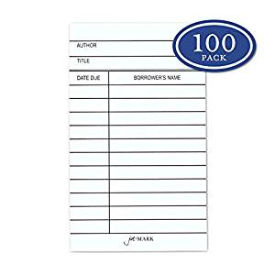
Federated Capital Corp. v. Abraham, 2018 UT App 117 (June 21, 2018)
Notes:
NJM:
The district court entered summary judgment in favor of the defendant in this breach of contract case on the basis the claims were barred by Pennsylvania’s four-year statute of limitations, which applied under the borrowing statute. On appeal, the plaintiff argued that the defendant failed to properly plead her statute-of-limitations defense, and thereby lost the right to pursue that defense because the defendant did not specify the statute on which the defense was based. The Court of Appeals held the plaintiff had waived this argument by failing to raise it in the district court. However, even if plain error review was available for the plaintiff, the defendant was entitled to rely on the statute of limitations defense because she identified the specific statute she was relying on in her motion for summary judgment and the plaintiff had the chance to respond to that argument, which is “all that is required.”

Slide 34
Appellate Issues

Slide 35
Rule 54(b) Certification
Copper Hills Custom Homes, LLC v. Countrywide Bank, FSB, 2018 UT 56 (Sept. 27, 2018)
EnerVest, Ltd. v. Utah State Engineer, 2019 UT 2 (Jan. 11, 2019)
Hayes v. Intermountain GeoEnvironmental Services Inc., 2018 UT App 223 (Nov. 29, 2018)
Notes:
NJM:
Copper Hills: The court held that when a court certifies its decision as final and appealable under Rule 54(b) based on lack of factual overlap between the claims, the certified order should “detail the lack of factual overlap between the certified and remaining claims” as well as include an “express determination by the district court that there is no just reason for delay,” and provide the district court’s reasoning for that determination.
Enervest: The Utah Supreme Court addressed two jurisdictional issues in this appeal from the district court’s rulings on competing motions for summary judgment in an expedited proceeding under Utah Code § 73-4-24(1) within a water rights general adjudication. The court first held the district court’s summary judgment rulings were not properly certified under Rule 54(b) because the district court did not articulate why it determined there was no just reason for delay; the denial of two of the parties’ motions for summary judgment was not a final order that would be appealable but for the fact other claims or parties remained in the action; and, due to the nature of general adjudications, there cannot be “complete finality of any water rights until the entire general adjudication has been completed.” The court then held that the only appellant lacked appellate standing because it was not “aggrieved” by the district court’s rulings, given that it had not objected to the State Engineer’s proposed determination with respect to the particular water right at issue. The Court’s discussion on these issues may have far-reaching implications in the Utah Lake/Jordan River general adjudication currently underway.
Hayes: In an appeal from dismissal of plaintiff’s claims against one of three defendants, the court of appeals determined that it lacked appellate jurisdiction because of a deficient certification order under Utah R. Civ. P. 54(b). The order stated only that the dismissal “is deemed a final order, thus starting [the] time for appeals.” Without an express determination that there is no just reason for delay, accompanied by supporting rationale under Rule 52(a), the order failed to properly invoke the jurisdiction of the court of appeals, requiring dismissal of the appeal.

Slide 36
Appellate Practice
Judd v. Bowen, 2018 UT 47 (Aug. 29, 2018)
True v. Utah Department of Transportation, 2018 UT App 86 (May 10, 2018)
Notes:
ALR
Judd: The supreme court revoked its grant of certiorari review after briefing and argument on the basis the criteria for certiorari set forth in Utah R. App. P. 46 were not present and certiorari had been improvidently granted. In doing so, the court discussed the bases for certiorari review and “encourage[d] future parties to keep in mind the guidelines we have set out in this opinion as they prepare their petitions for certiorari.”
True: Despite recognizing a significant change in case law that had occurred after the district court’s grant of summary judgment, the Utah Court of Appeals held that the Trues had an opportunity to raise the argument in a post-trial motion, and by failing to do so, could not raise the argument on appeal. This case also provides a thorough description of the preservation requirement and the policies behind it.

Slide 37
Rule Changes?
Rule 46: Considerations for Certiorari
Rule 50: Response / Amicus Curiae
Notes:
https://www.utcourts.gov/utc/rules-approved/category/rules-of-appellate-procedure/

Slide 38
Attorney-Client Privilege

Slide 39
Krahenbuhl v. The Cottle Firm, 2018 UT App 138 (July 12, 2018)
Notes:
ALR:
In this legal malpractice case, the plaintiffs filed an interlocutory appeal of the district court’s denial of their objection to a subpoena duces tecum issued by the defendant-counsel to successor counsel the plaintiffs had retained to continue their representation in the underlying case. The court of appeals agreed with the plaintiffs that the subpoena violated the attorney-client privilege and reversed the district court’s decision. It held the “at issue” exception to the attorney-client privilege does not apply in this case because the defendants’ defense, and not the plaintiff’s claims, put the correspondence with successor counsel at issue, or made them potentially relevant. In doing so, it rejected the defendants’ argument that by filing a legal malpractice claim against one lawyer in the underlying case, a plaintiff waives the privilege with respect to all lawyers who represented him in the underlying case.

Slide 40
Thank You!
Questions?
Comments?
Copies of summaries available.
Contact:
Andrew Roth
alr@scmlaw.com
801-322-9314
Nate Mitchell
njm@scmlaw.com
801-322-9330

